Slide 1
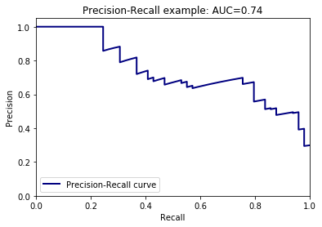
Precision-Recall
Notes:
ppt figures are for svm
This is overall score

Slide 2
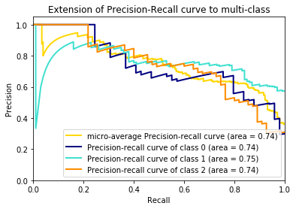
Precision-Recall
Notes:
Separate score for each class

Slide 3
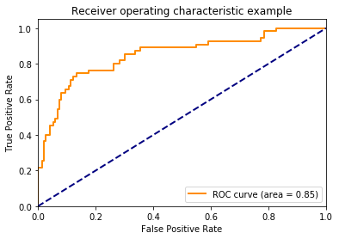
ROC
Notes:
This is the ROC curve

Slide 4
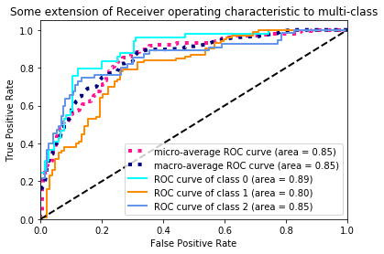
ROC
Notes:
ROC for separate class

Slide 5
Next step
Summarized the results
This week I did :
Comparing different classifiers. (SVM,Naïve Bayes, Random Forest)
Tune Parameters (automatic)
Notes:
Next step

Slide 6
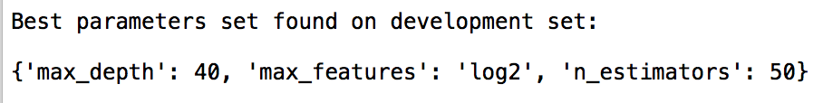
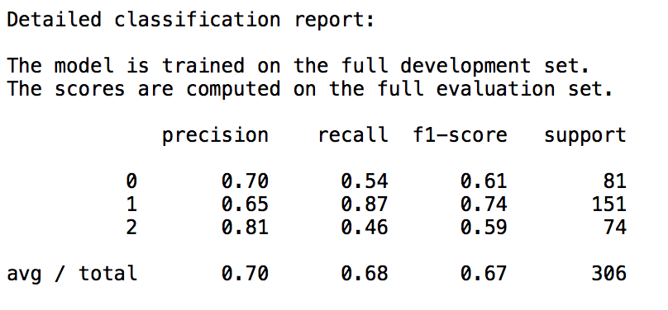
Random Forest
Notes:
optimize

Slide 7
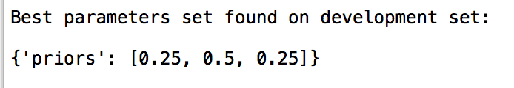
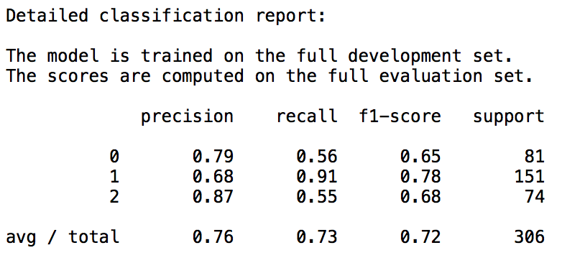
Naïve Bayes

Slide 8
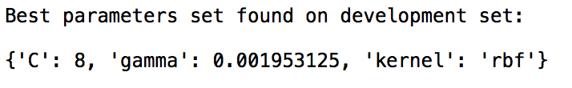
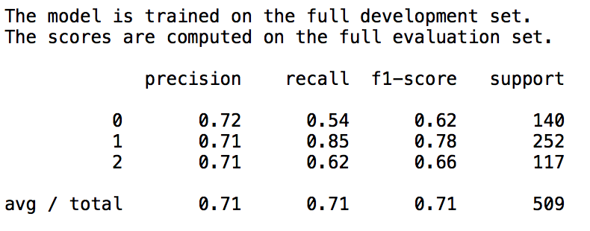
SVM

Slide 9
Next steps
Finish the graphs
Integrate the methods,results and start write
I basically got the results, and next I’ll try to finish all the graphs, and summarize all the experiment process.
Yes,

